Slide 1



Analysis of Insurance Rates
By Laurids Klevenhaus

Slide 2

For this project I used Excel to analyse the data and gather findings

Slide 3
Analysis Brief
Problem statement: Management wants to have better informed insurance agents.
Goal: To create a guide for insurance agents to help estimate insurance rates based on customer characteristics.
Task: Analyze, hypothesize and create a data story on key influencers of insurance rates
Questions from management:
What does our typical customer look like?
What customer traits raise or lower insurance rates?
Do we typically charge more by gender?
What is the one trait that skyrockets cost?

Slide 4
Data Brief
Data is provided as a CSV file, has approx. 1300 customer records with 7 columns.
Age
Sex
BMI
Children
Smoker
Region
Insurance charges

Slide 5
So, let’s get started with the analysis!

Slide 6
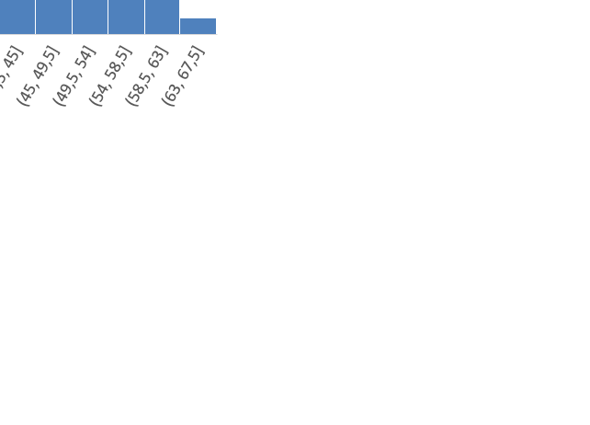
What does our typical customer look like?
…We have equally large groups of customers from each region
…Majority have 0 children (43%)
…Is equally distributed between men and women
39 years avg. age
30,6 avg. BMI
$13.270 average rate
…80% are non-smokers
…A high amount of 18-23 year olds, otherwise equally distributed age groups from 23-63

Slide 7
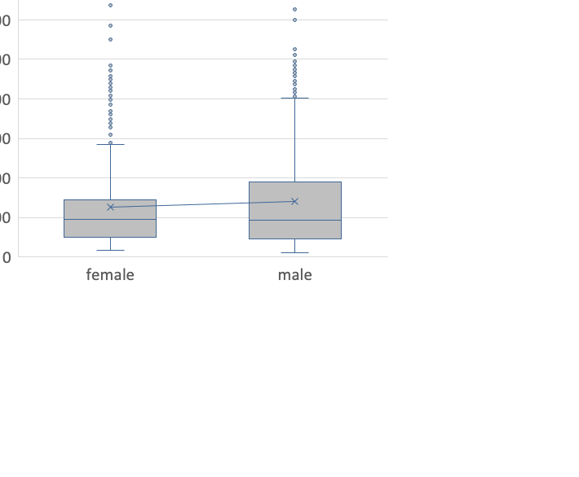

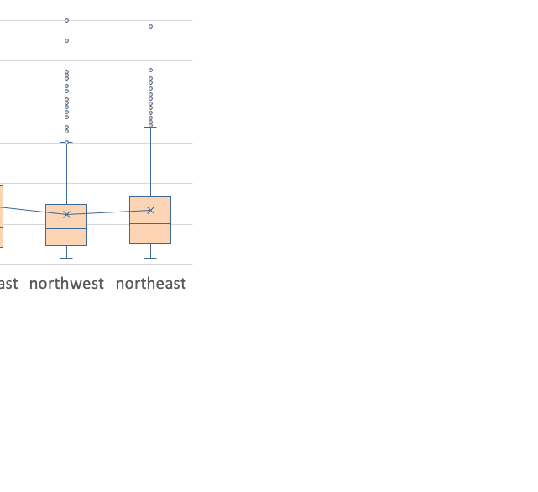
What categories have the highest charges?
Male customers pay 10% more on average than female
Southeast has the highest average charge at 14.7K
Average smoker rates are 4X higher

Slide 8
Now we want to know what factors contribute to a higher insurance rate e.g., what factors might correlate with charges

Slide 9
What is correlated with higher charges?
Correlation: 0,3
Correlation: 0,2
The relationship between variables:
We can see that in the data that when age and BMI increases, so does the insurance charges. These are positively correlated at 0,3 and 0,2 which is low. However, these two factors are just observations, there might be other factors driving the insurance rates which we will look into in the regression part.

Slide 10
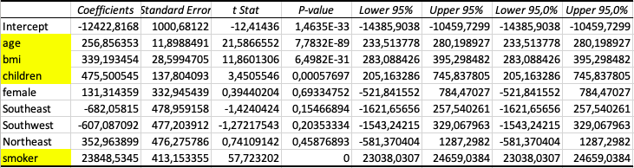
So, what drives the insurance rates upwards? We can use regression to move from correlation to causation
$23.848,53
Linear regression was used to help explain increases in the insurance rates based on the model above. Age, BMI, Children and Smoker were all significant factors at the 0,05 p-value. If a customer is a smoker, the insurance rises by $23.848,53
$256,86
$339,19
$475,5
Age
BMI
Children
Smoker

Slide 11
Summary & Recommendation
Summary:
Although there are many factors that correlate with both increases and decreases in insurance rates, the most significant factors that change insurance rates are:
Smoking (~$24K↑)
# of Children (~$475↑)
Increases in BMI (~$339↑)
Advancing age (~$256↑)
* Per one unit increase
Summary:
Although there are a combination of factors that increases rates, insurance agents can use these factors to discuss and and to give a very general estimate on increases to overall rates. Alternatively, we can use these values to create a prediction formula for agents to use after inputting the specifics.

